Slide 1
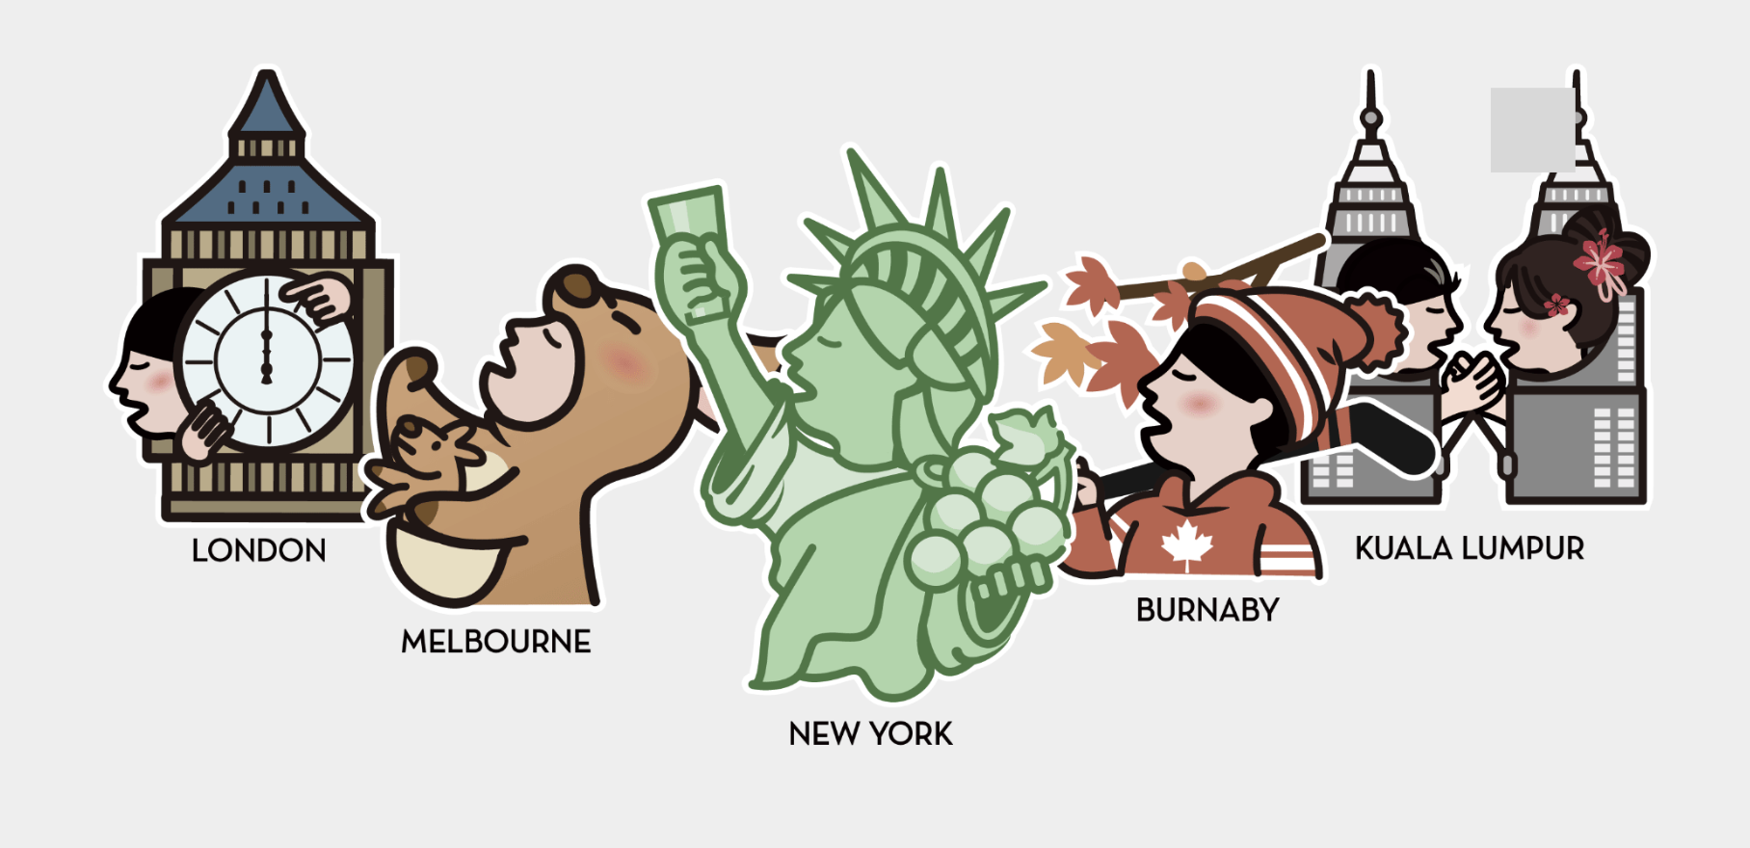
HEYTEA
Customers in Boston
Lifu Li, Ruoxian Zhang, Yiyou Chen, Lujia Yu, Xingzhu Chen, Bei Su, Fangzhou Zheng

Slide 2
Contents
1. Project Background & Client Goals
2. Feedback Incorporated
3. Data Collection & Respondent Demographics Overview
4. A/B Test Analysis & Findings
5. Consumer Experience Survey Analysis & Findings
6. Summary & Recommendations
7. What we can improve
8. Appendix

Slide 3
Project Background & Client Goals
Project Goals: Support HEYTEA in successfully localizing its brand in Boston as part of its international expansion.
Client Introduction:
HEYTEA, founded in 2012 in Jiangmen, Guangdong, has revolutionized the traditional Chinese tea market by introducing modern elements like cheese-topped and milk cap teas. Focused on quality and innovation, HEYTEA has become a leading tea brand, known for its stylish stores and engaging customer experiences. The brand has expanded globally, including a notable location in Allston, Boston, representing its international reach in tea culture.
Understand Boston consumer needs
Measure current customer satisfaction
Identify consumer preferred offer types
#1 Approach
#2 Approach
#3 Approach
Focus Group Customer Interviews
Public Survey of Customers Experience Satisfaction
A/B Test on Offer Effectiveness

Slide 4
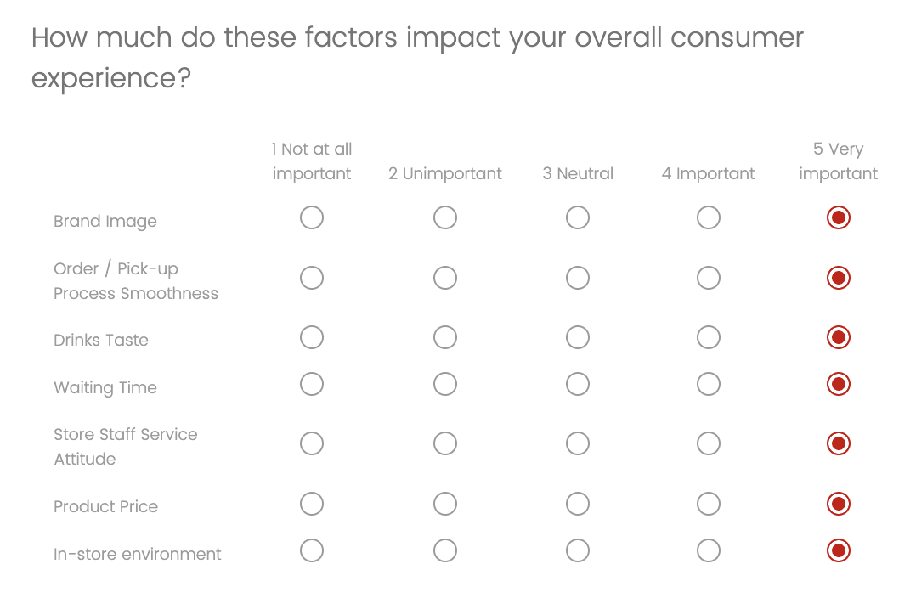
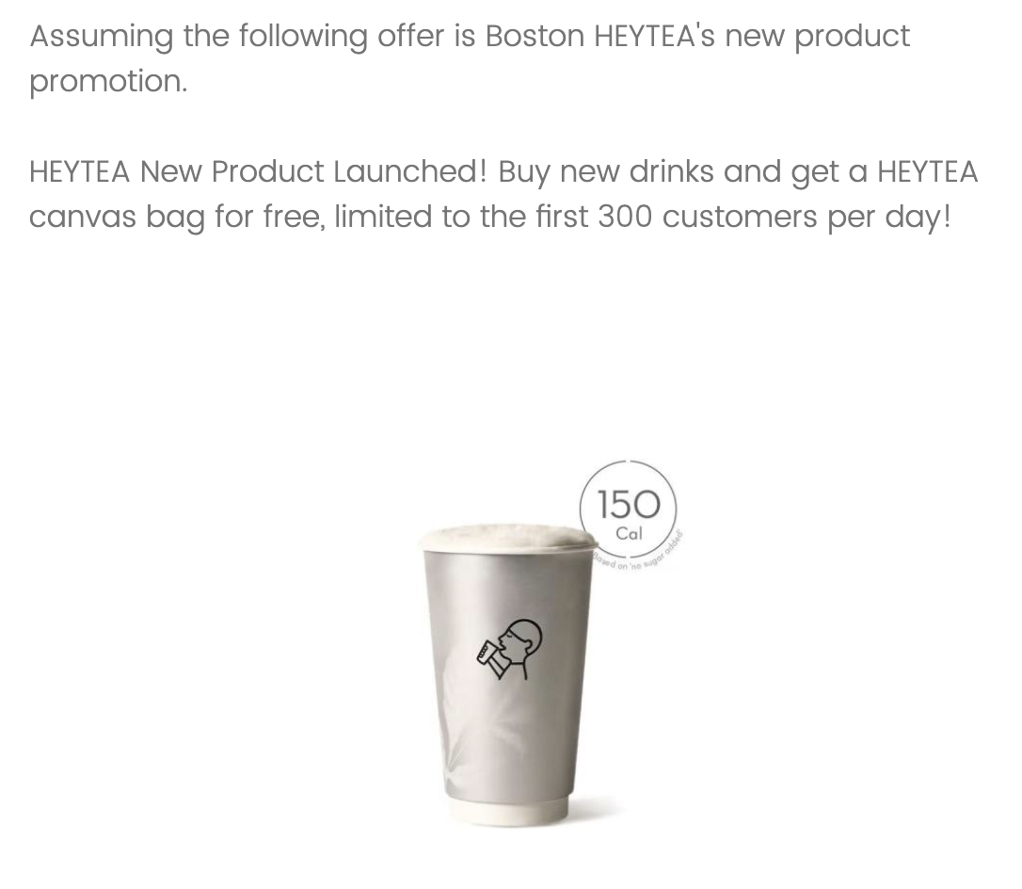
Feedback Incorporated
Survey Structure and Content Refinement
Rating scales need clear labels.
Clarify visit frequency.
Polish formatting for consistency.
Simplify “Taste & Quality” question into “Taste” only.
Modify A/B Test offer types → BOGO or Canvas Bag.
Language and Wording Improvements
Simplify wording and replace confusing terms.
Fix casing, spelling.
Improve phrasing of experience questions.
Visual and Branding Enhancements
Provide a short brand introduction at the beginning.
Resize HEYTEA logo.
Add product image.

Slide 5
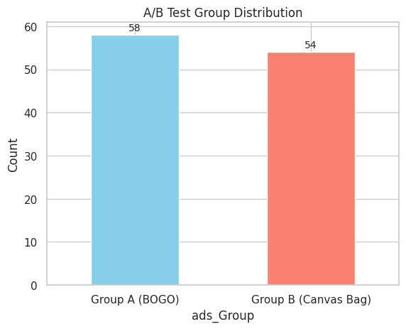
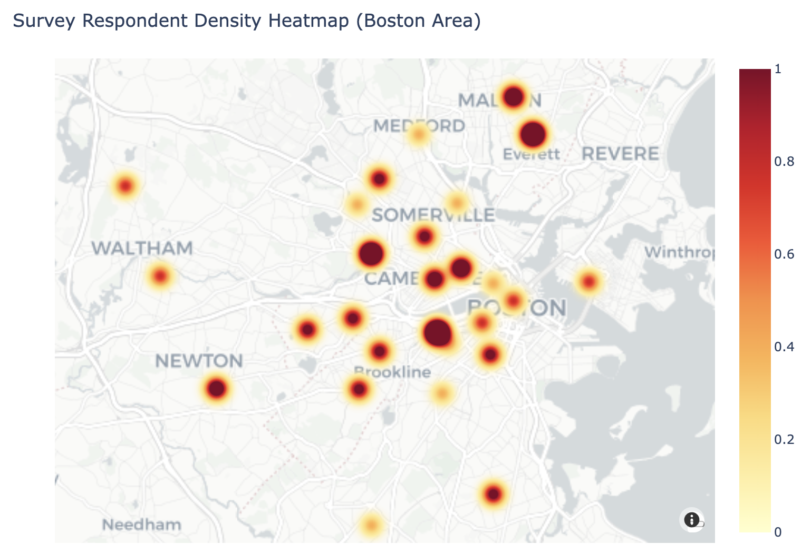
Data Collection
147
Responses
Sampling Method Purposive Convenience Sampling: Mainly targeting Chinese international students via Social Media and Residential Communities.
Data Cleaning Principle Who we ruled out:
Unfinished Respondents
Respondents outside the Greater Boston Area.
Outliers like taking more than 15 minutes to finish the Survey.
Raw Data
112
Valid Tracks
Clean Data
112
Tracks
A/B Test Survey
Consumer Satisfaction Survey
78
Users
Further Analysis
Notes:
Select those respondents who have shopped in HEYTEA Boston store – 78 users

Slide 6
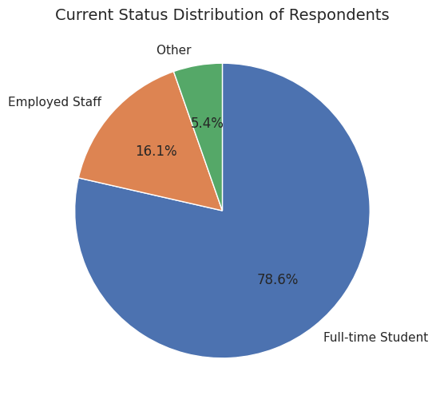
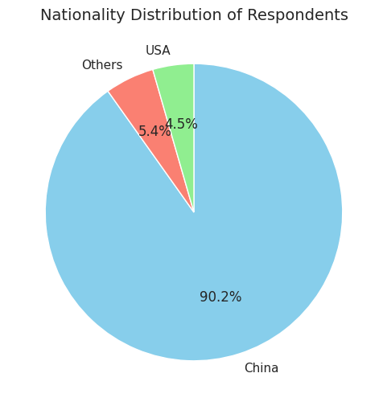
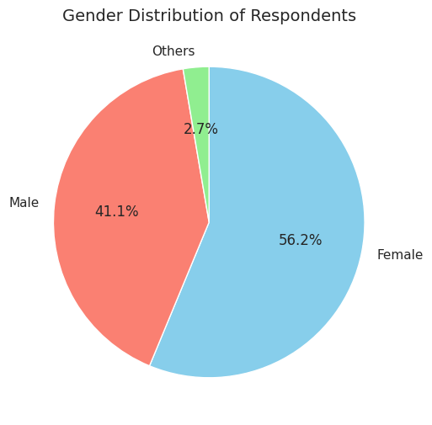
Respondent Demographics Overview
Current Status: 78.6% are full-time students, 16.1% employed, 5.4% others.
Nationality: 90.2% are from China, followed by 4.5% from the USA.
Gender: 56.2% female, 41.1% male, 2.7% others.

Slide 7
Part 1.
A/B Testing

Slide 8
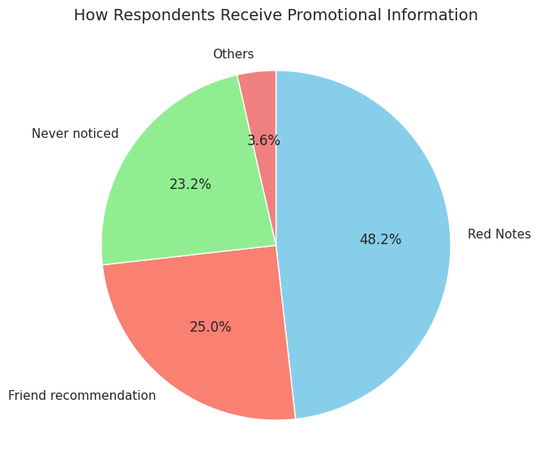
Exploratory Data Analysis
Pt.1 A/B Test Survey Outcome：
Distribution of channels through which users receive offer information: Red Notes is the top source, followed by friend recommendations.
Which type of offers has better effect: The Canvas Bag offer wins Buy-One-Get-One-Free in all four aspects: willingness to order, appealing level, competitiveness, and recommending to friend.
Further Analysis：
Analysis 1: Gender Distribution Across Promotional Offer Groups (Chi-Square Test)
Analysis 2: Effect of Promotion Type on Likelihood to Place an Order (Independent Samples t-test)
Analysis 3: Effect of Promotion Type on Recommendation Rate (Chi-Square Test)
Analysis 4: Relationship Between Gender and Recommendation Likelihood (Chi-Square Test)

Slide 9
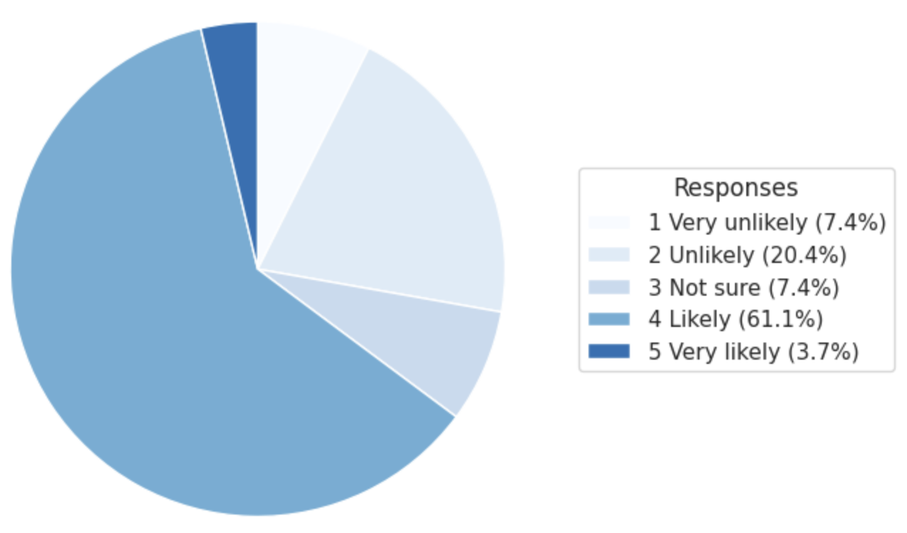
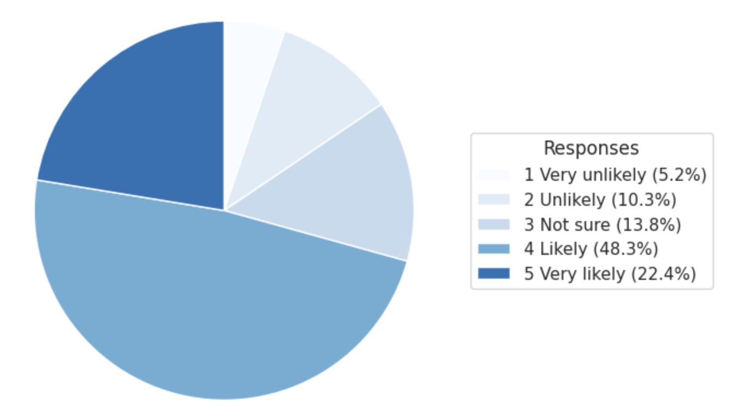
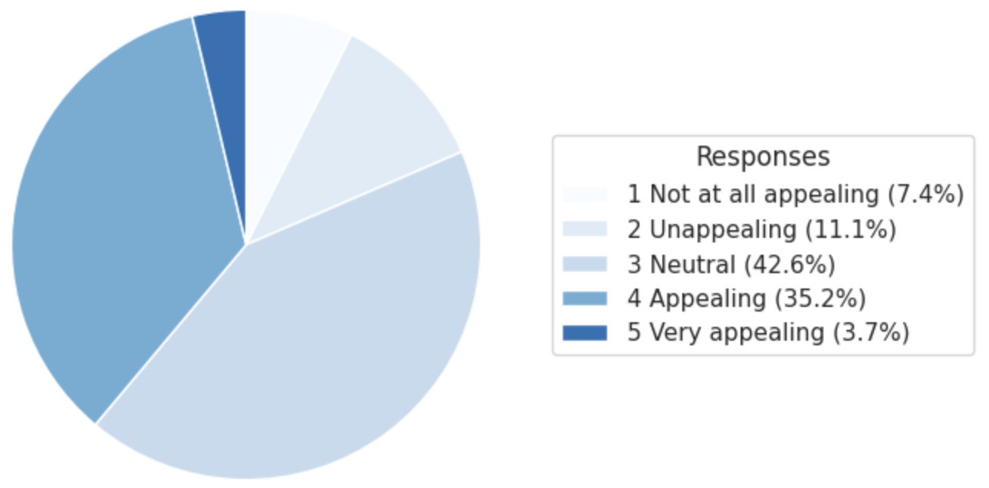
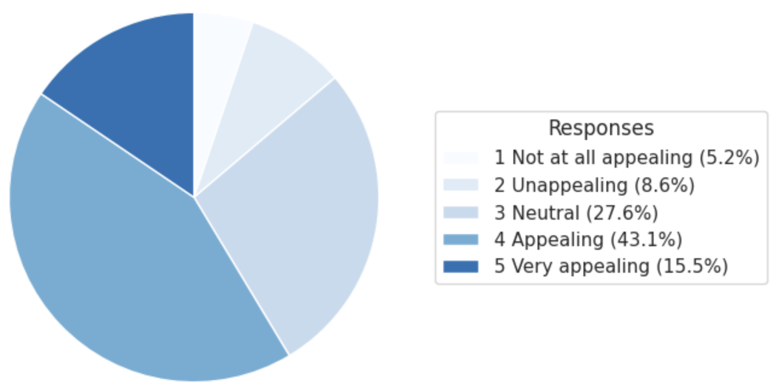
BOGO
VS
Canvas Bag
Willingness to order
Appealing level

Slide 10
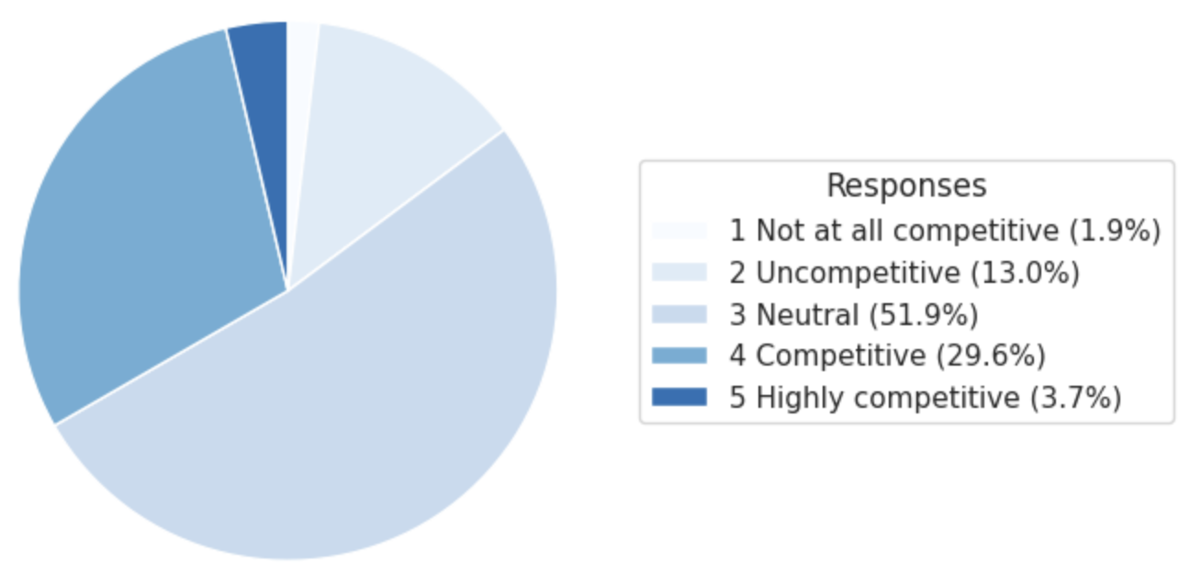
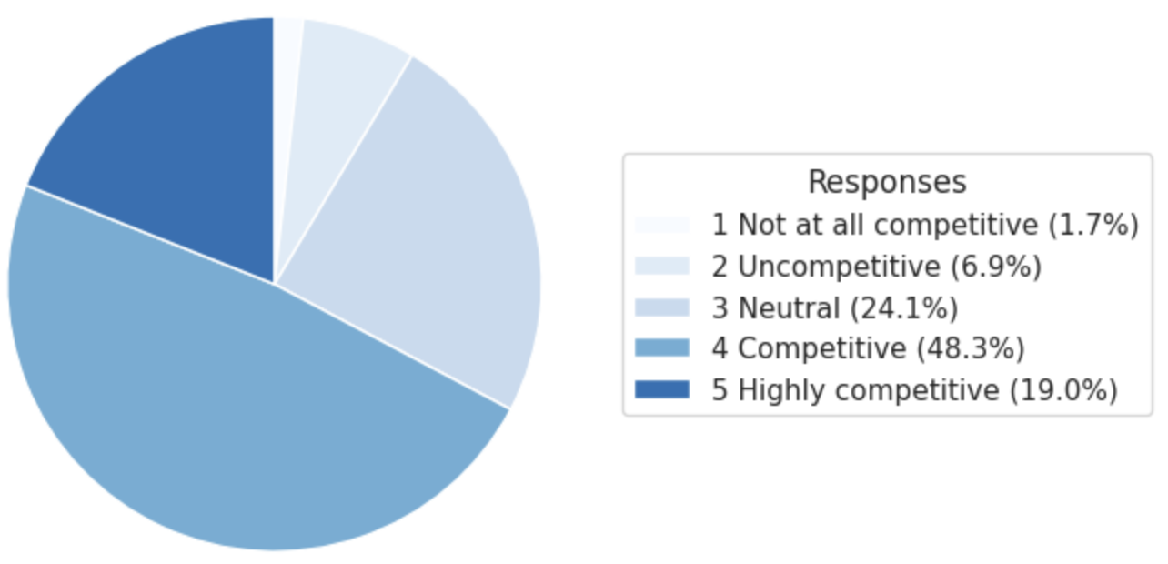
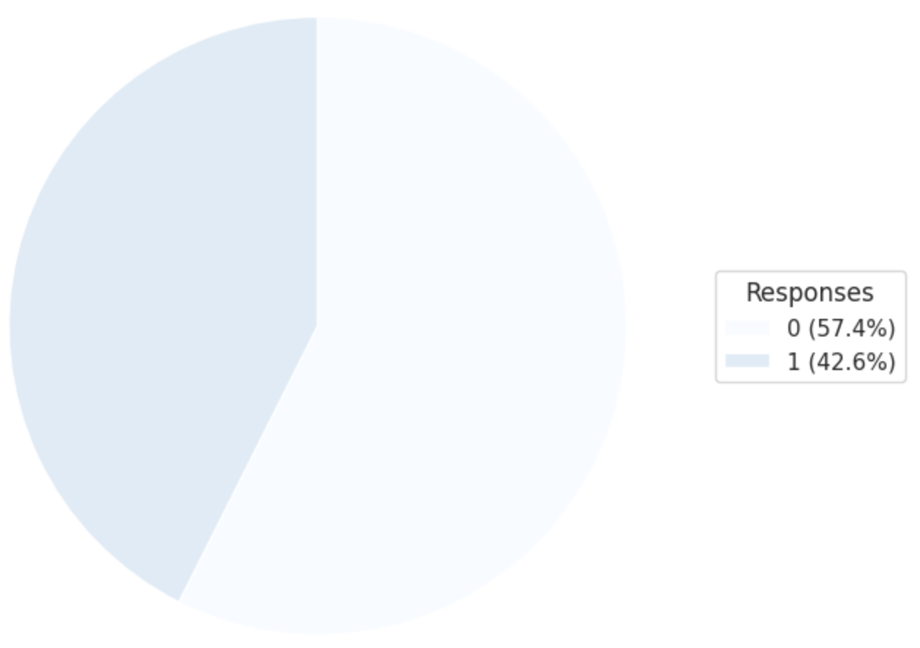
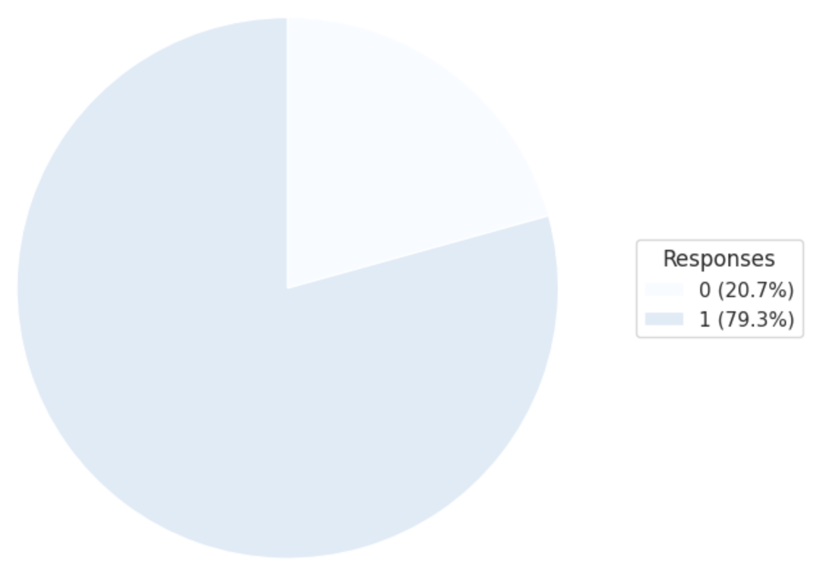
BOGO
VS
Canvas Bag
Comparing with competitors
Recommend to friends

Slide 11
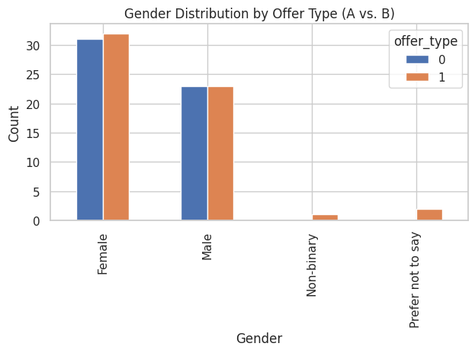
Analysis 1: Gender Distribution Across Promotional Offer Groups (Chi-Square Test)
Measure: Gender distribution across BOGO and Canvas Bag offer groups.
Test: Chi-square test of independence.
Hypothesis: The gender composition would not differ significantly between promotional groups.
Results:
χ² = 2.88, p = 0.4110 (not statistically significant).
Gender proportions (female, male, non-binary, prefer not to say) were highly similar across groups.
Marketing Implications: The random assignment of promotional offers was balanced across genders. Therefore, observed differences in recommendation rates between offers can be attributed to the offers themselves, not gender bias.

Slide 12
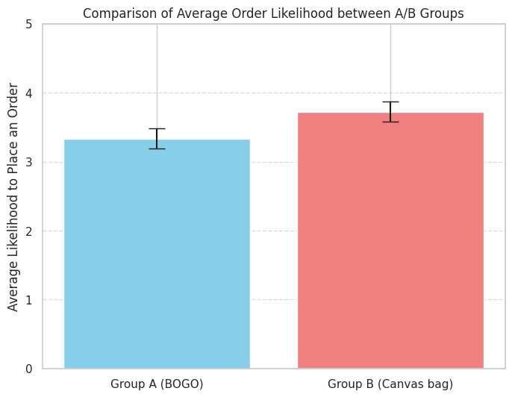
Analysis 2: Effect of Promotion Type on Likelihood to Place an Order (Independent Samples t-test)
Measure: Customers' likelihood of placing an order (1–5 scale) under different promotions (BOGO vs. Canvas Bag).
Test: Independent samples t-test.
Hypothesis: The type of promotional incentive significantly affects ordering intent.
Results:
Group A (BOGO): mean = 3.33; Group B (Canvas Bag): mean = 3.72.
t = -1.905, p = 0.059 (significant at 10% level).
Marketing Implications: Offering tangible gifts, such as a branded canvas bag, is more effective in stimulating purchase intent than price-based promotions.

Slide 13
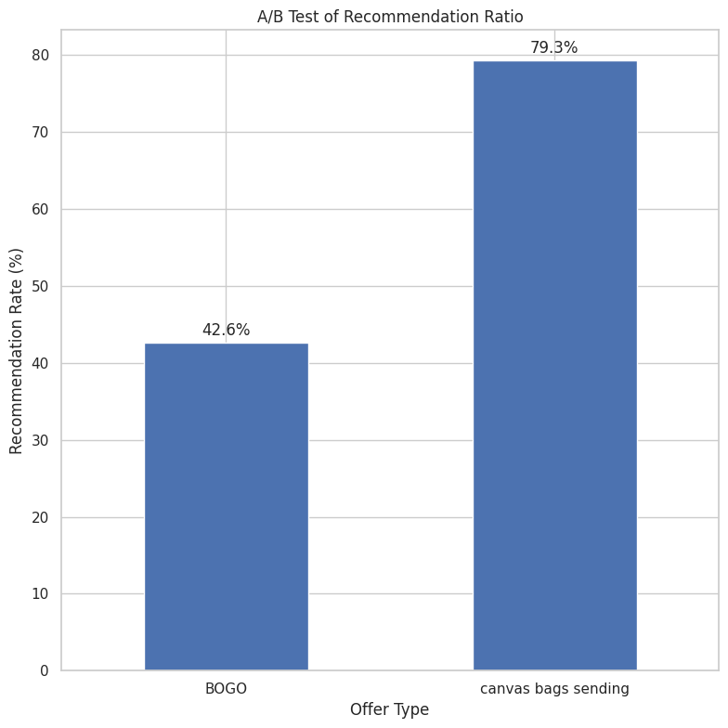
Analysis 3: Effect of Promotion Type on Recommendation Rate (Chi-Square Test)
Measure: Recommendation rates (%) under different promotions (BOGO vs. Canvas Bag). Test: Chi-square test of independence.
Hypothesis: Promotion type significantly affects the likelihood of recommendation.
Results:
BOGO: 42.6% recommendation rate; Canvas Bag: 79.3%.
χ² = 14.42, p < 0.001.
Marketing Implications: Gift-based promotions substantially enhance customers' willingness to recommend the brand, suggesting higher viral potential compared to traditional discount incentives.

Slide 14
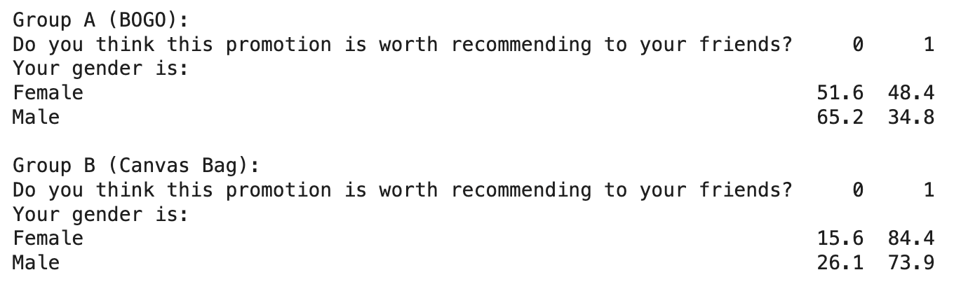
Analysis 4: Relationship Between Gender and Recommendation Likelihood (Chi-Square Test)
Measure: Gender (binary coded) and likelihood to recommend the promotion.
Test: Chi-square test of independence.
Hypothesis: Gender differences exist in consumers' willingness to recommend.
Results: χ² = 1.223, p = 0.269 (not statistically significant).
Marketing Implications: Recommendation behaviors do not differ significantly by gender; campaigns can be targeted uniformly across male and female audiences.

Slide 15
Part 2.
Consumer Experience

Slide 16
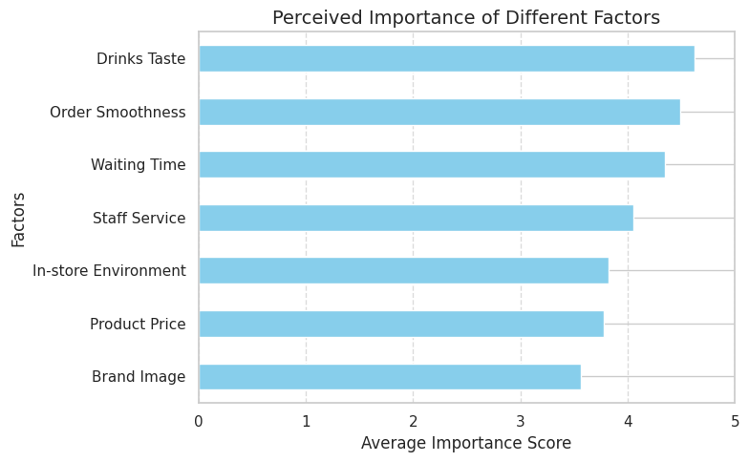
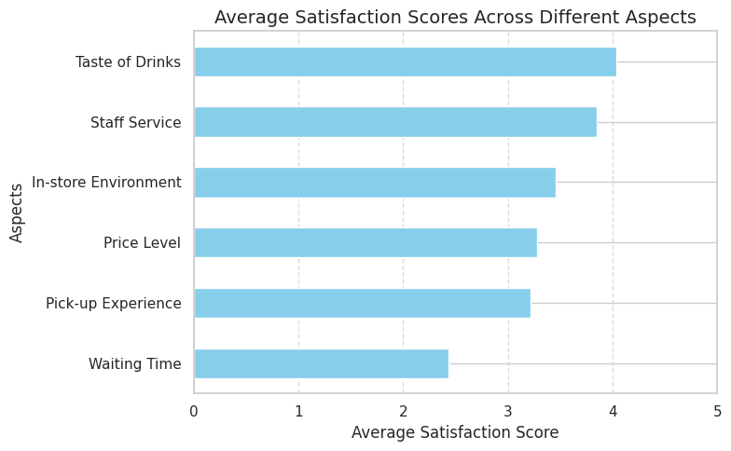
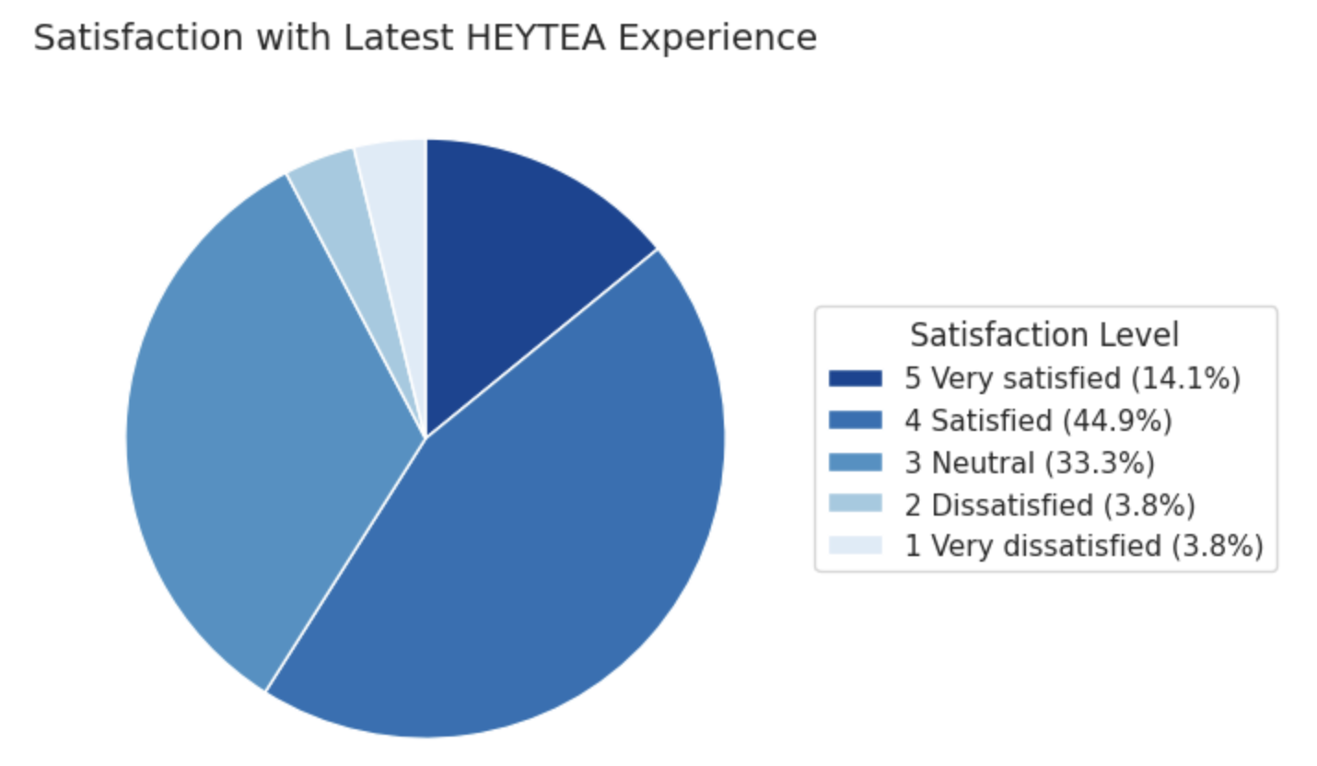
Exploratory Data Analysis
Pt.2 Consumer Experience Survey：
Results on the importance of factors affecting satisfaction: Factors like drink taste, order smoothness, and waiting time are considered most important for satisfaction.
Current actual overall satisfaction: Overall, most respondents reported being satisfied or neutral about their latest HEYTEA experience.
Satisfaction with various factors: Satisfaction is highest for drink taste but lower for pick-up experience and waiting time.

Slide 17
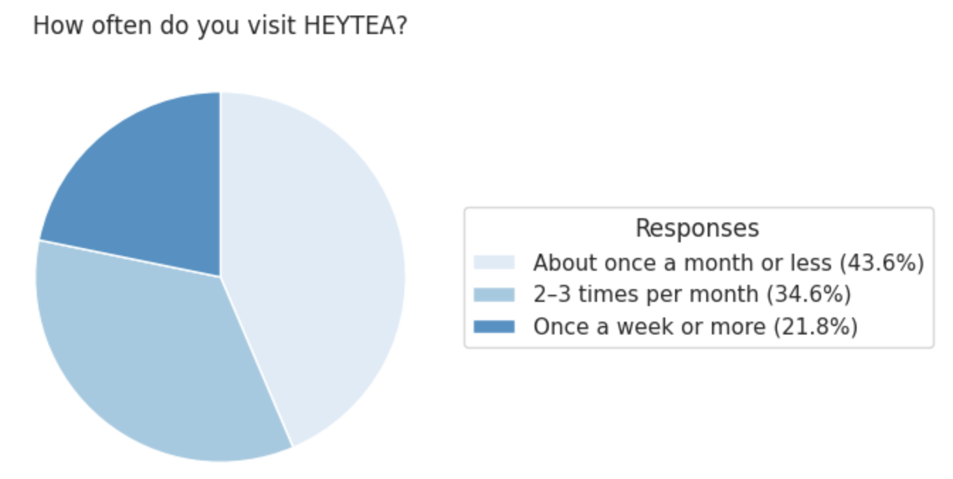
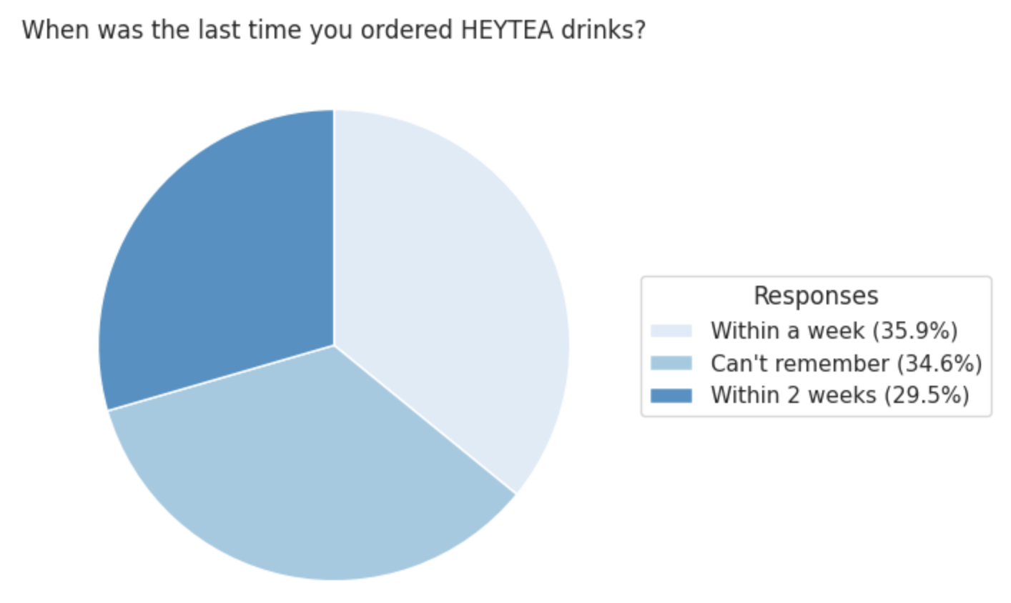
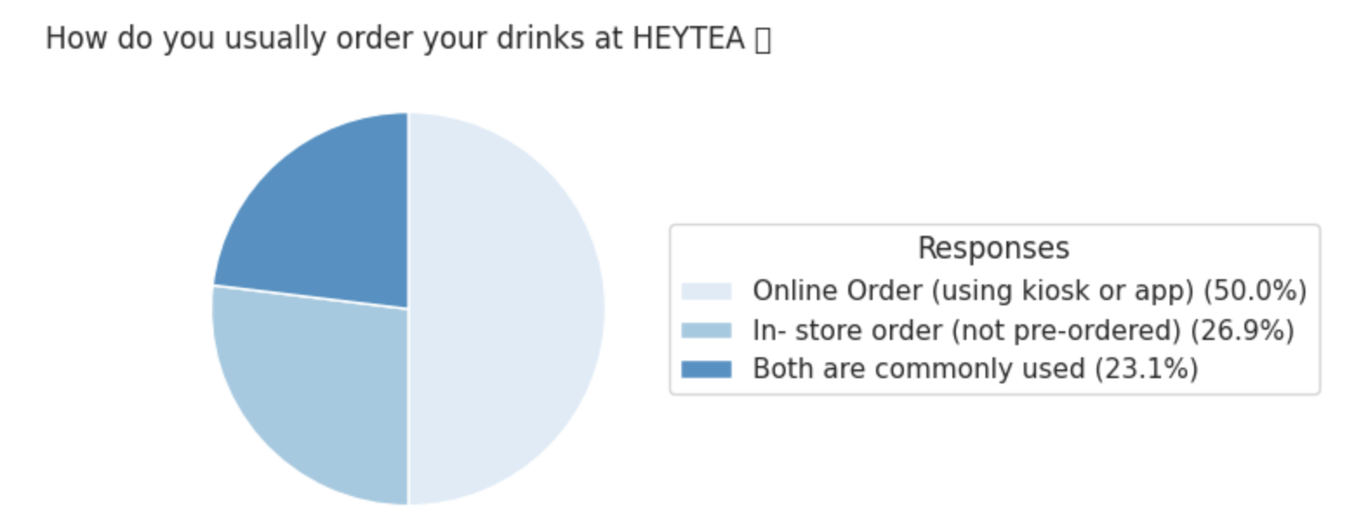
Context of Consumer Behavior
Most respondents visit HEYTEA about once a month or 2–3 times per month. Responses regarding the last purchase time were fairly evenly distributed across the three options. Half of the respondents typically place orders online via kiosk or app, while the rest prefer in-store ordering or use both methods.

Slide 18
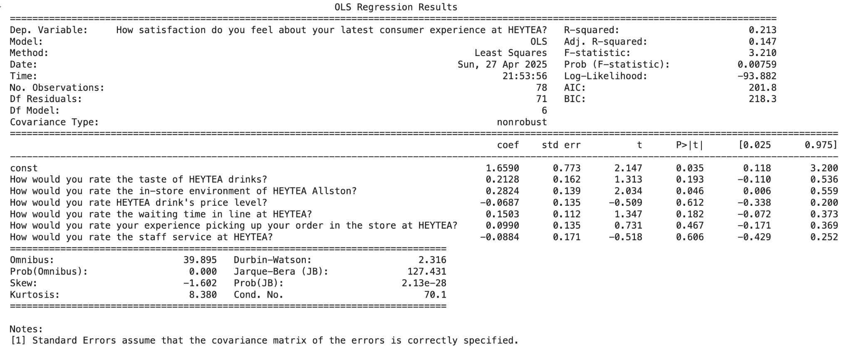
Analysis 5: Predictors of Customer Satisfaction (Multiple Linear Regression)
Measure: Overall satisfaction as the dependent variable; ratings of drink taste, in-store environment, price level, waiting time, pick-up experience, and staff service as predictors. Test: Multiple linear regression. Hypothesis: Customer experience factors significantly predict overall satisfaction. Results: · Significant predictors:
· In-Store Environment :
(β = 0.2824, p = 0.046) · Taste & Wait time were close to significance
· R² = 0.213
Marketing Implications: The physical environment is the primary
driver of satisfaction. HEYTEA should
prioritize improving store layout, ambiance,
cleanliness, and design to enhance
customer perceptions and encourage loyalty.

Slide 19
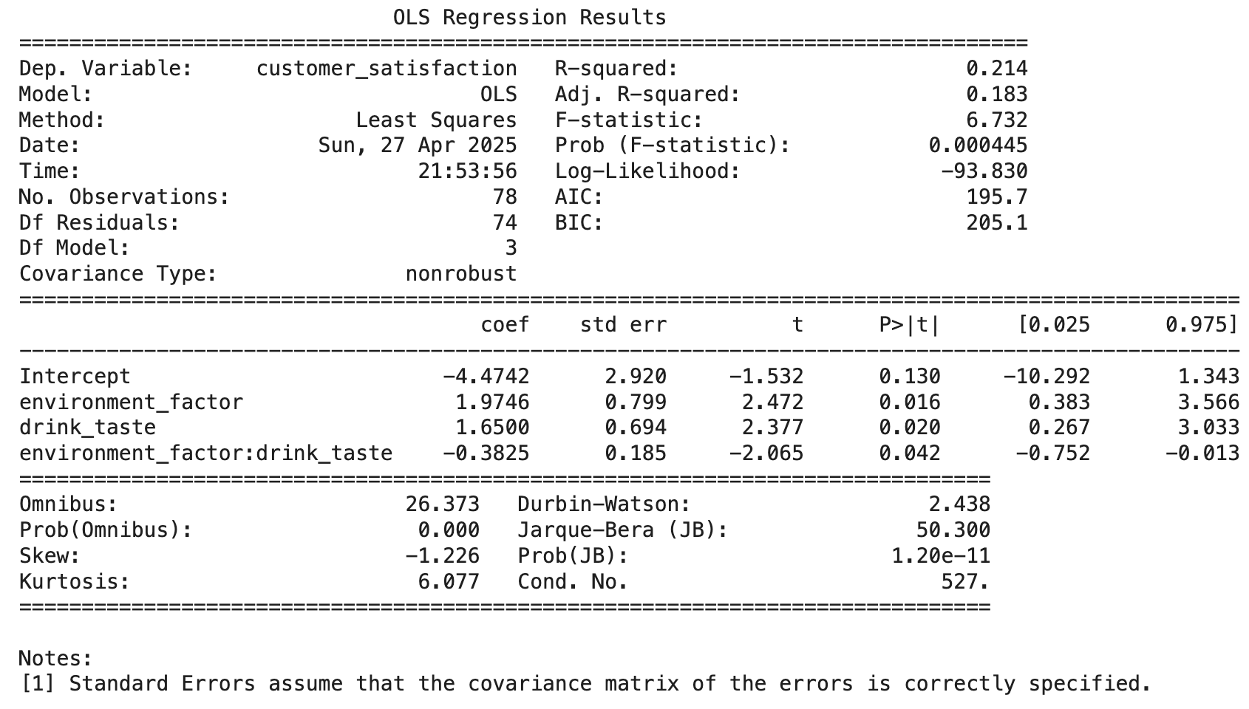
Analysis 6: Effects of Environment, Drink Taste, and Interaction on Satisfaction (Multiple Regression with Interaction)
Measure used: Satisfaction predicted by environment, drink taste, and their interaction.
Test conducted: Multiple linear regression.
Hypothesis: Environment, taste, and their interaction affect satisfaction.
Results:
Environment (β = 1.975, p = 0.016), Taste (β = 1.650, p = 0.020), Interaction (β = -0.382, p = 0.042).
R² = 0.214.
Marketing Implications: Balance improvements between drink quality and store environment; avoid over-investment in just one.

Slide 20
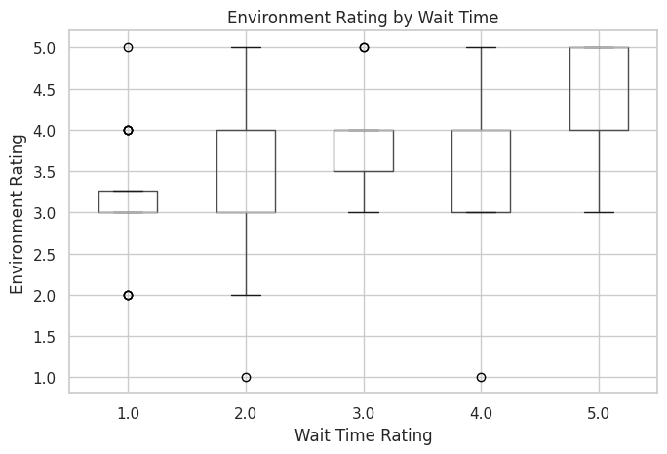
Analysis 7: Relationship Between Wait Time and Environment Rating (Pearson Correlation)
Measure: Wait time (1–5 scale) and in-store environment rating (1–5 scale).
Test: Pearson correlation analysis.
Hypothesis: Wait time satisfaction is not associated with in-store environment satisfaction ratings.
Results:
r = 0.3222, p = 0.0040 (moderate positive, statistically significant).
Marketing Implications: A moderate positive correlation was found between customers' satisfaction with waiting time and their satisfaction with the in-store environment, indicating that higher satisfaction with waiting time is linked to better perceptions of the store environment. Improving the waiting experience — through queue management, in-line entertainment, or faster service — can enhance overall brand perception and strengthen customer loyalty.

Slide 21
Summary of findings
A/B Test Survey Findings:
Channel Source: Red Notes is the top channel, followed by friend recommendations.
Offer Effectiveness: Canvas Bag offer outperforms BOGO across all four metrics (order willingness, appeal, competitiveness, recommendation).
Gender Balance: No significant gender difference between BOGO and Canvas Bag groups (χ² = 2.88, p = 0.4110).
Order Likelihood: Canvas Bag offer leads to higher ordering intent (t = -1.905, p = 0.059).
Recommendation Rates: 79.3% (Canvas Bag) vs. 42.6% (BOGO); highly significant difference (χ² = 14.42, p < 0.001).
Gender and Recommendation: No significant gender effect on recommendation behavior.
Consumer Experience Survey Findings:
Key Satisfaction Drivers: Drink taste, order smoothness, and waiting time are most important.
Customer Behavior: Majority visit 1–3 times per month; half order via kiosk or app.
Satisfaction Predictors: In-store environment significantly predict overall satisfaction (R² = 0.213).
Environment-Taste Interaction: Both factors and their interaction significantly influence satisfaction (R² = 0.214).
Wait Time and Environment Perception: Moderate positive correlation (r = 0.3222, p = 0.0040); better waiting experience enhances environment ratings.

Slide 22
Summary of findings
Part | Measure | Test | Key Results | Marketing Implications
A/B Test | Gender Balance Check | Chi-square Test | χ² = 2.88, p = 0.4110 (not significant) | Gender-balanced randomization ensures fair comparison.
A/B Test | Order Likelihood | Independence T-test | t = -1.905, p = 0.059 (significant at 10%) | Canvas Bag more effective than BOGO in stimulating orders.
A/B Test | Recommendation Rates | Chi-square Test | χ² = 14.42, p < 0.001; Canvas Bag: 79.3% vs. BOGO: 42.6% | Gift promotions have higher viral potential.
A/B Test | Gender vs. Recommendation | Chi-square Test | χ² = 1.223, p = 0.269 (not significant) | No gender-specific targeting needed for recommendation campaigns.
Consumer Survey | Factors Importance | Descriptive | Taste, order smoothness, and waiting time are most important. | Prioritize key satisfaction drivers as taste, order smoothness & waiting time.
Consumer Survey | Overall Satisfaction Drivers | Multiple Regression | In-store environment, β = 0.2824, p = 0.046, R²=0.213 | Focus on in-store environment improvement.
Consumer Survey | Environment, Taste Interaction | Multiple Regression | Environment, Taste, Interaction all significant; R²=0.214 | Balance investments across store environment and product taste.
Consumer Survey | Wait Time vs. Environment | Pearson Correlation | r = 0.3222, p = 0.0040 (moderate positive) | Improving wait time experience enhances environment perception.

Slide 23
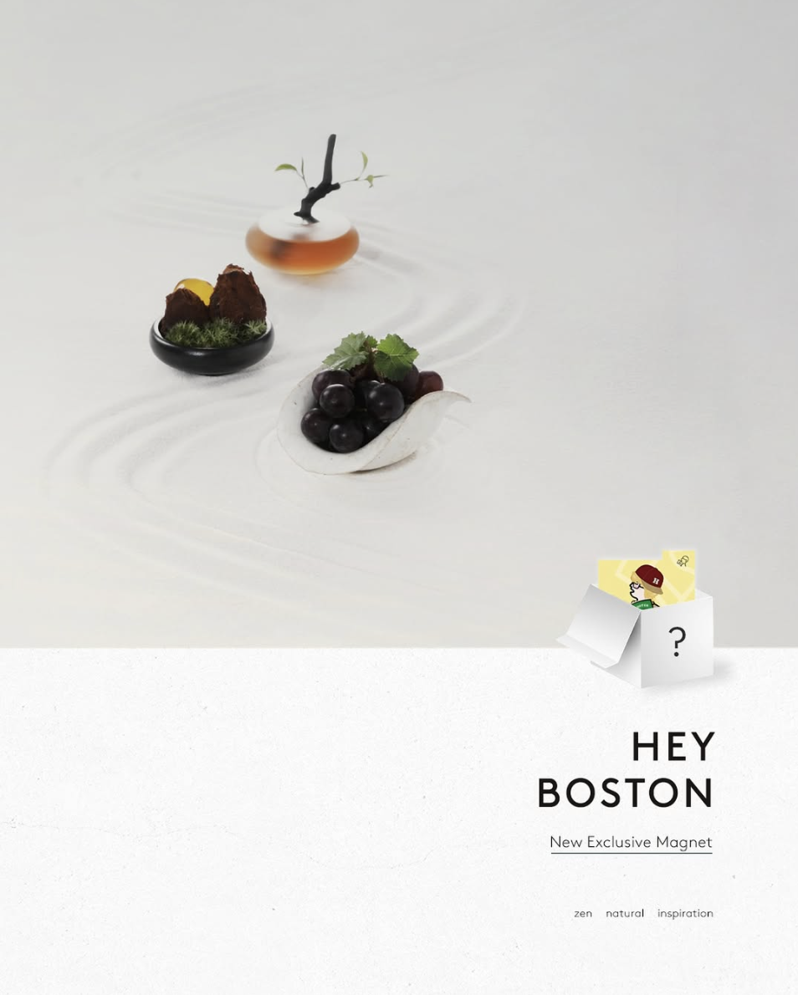
Recommendations & Final Call-to-action
Surprising Findings:
Tangible gifts beat price discounts: The canvas bag offer significantly outperformed BOGO across all key metrics.
In-store environment perception matters more than expected: Improving waiting experience can notably enhance environment satisfaction.
No gender differences in recommendation behavior: Campaigns do not need gender-based targeting.
What We Recommend:
Think: Promotions are not just about discounts — emotional and tangible rewards drive stronger loyalty.
Feel: Creating a smooth, enjoyable experience at every touchpoint builds brand love and customer retention.
Do: ▪ Launch gift-based promotional campaigns (e.g., branded merchandise). ▪ Invest in improving perceived waiting experience (e.g., faster service, in-line entertainment). ▪ Leverage Red Notes and social sharing to amplify promotion visibility. ▪ Maintain consistent messaging across all customer segments.

Slide 24
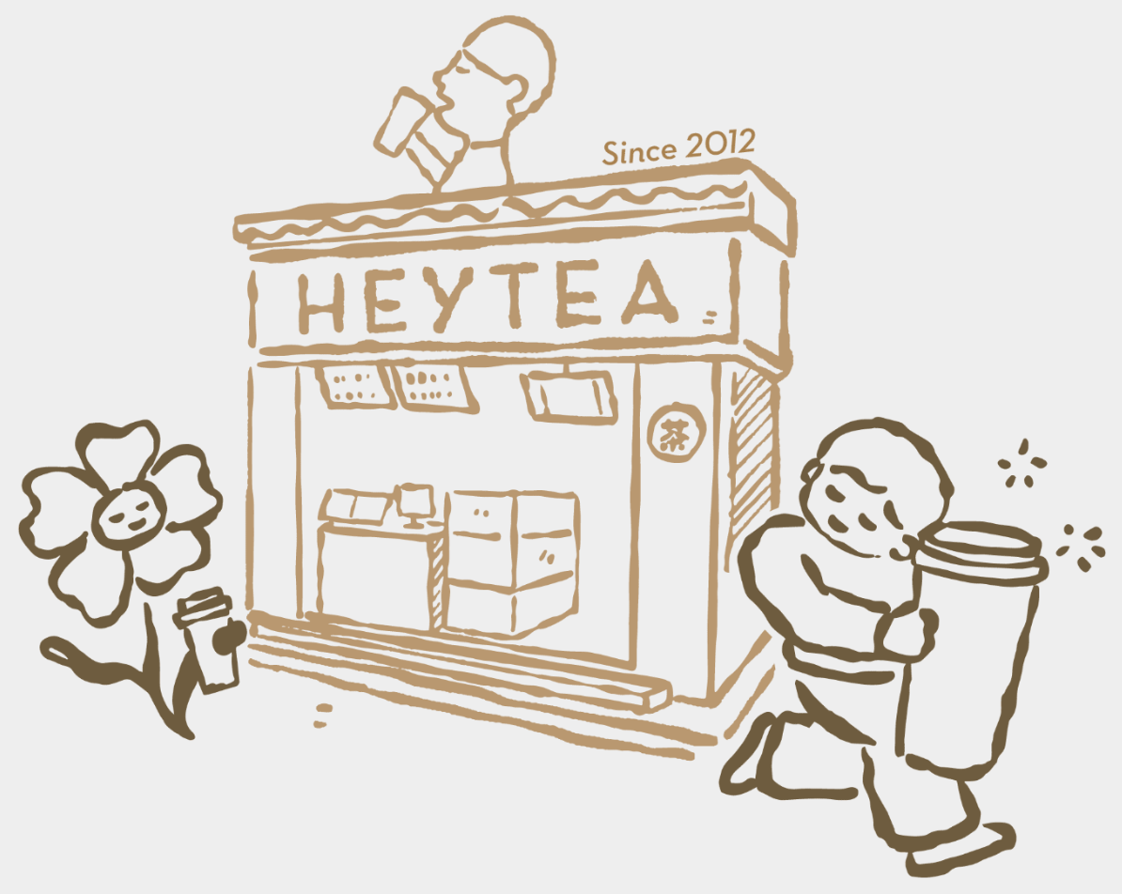
What we can improve:
Sampling Methodology While targeting Chinese international students was intentional, relying on convenience sampling may introduce bias and limit the randomness of the sample. Future efforts could incorporate quota sampling or stratified sampling within the target group to improve representativeness.
Expand channels for participant recruitment Relying mainly on WeChat groups and residential communities may limit diversity within the target population. Future surveys could also leverage university mailing lists, student associations, and offline intercept methods to access a broader cross-section of Chinese international students.
Balance question formats to reduce survey fatigue Introducing more varied question types (e.g., sliders, dropdowns, short text) could make the survey more engaging and improve response quality.

Slide 25
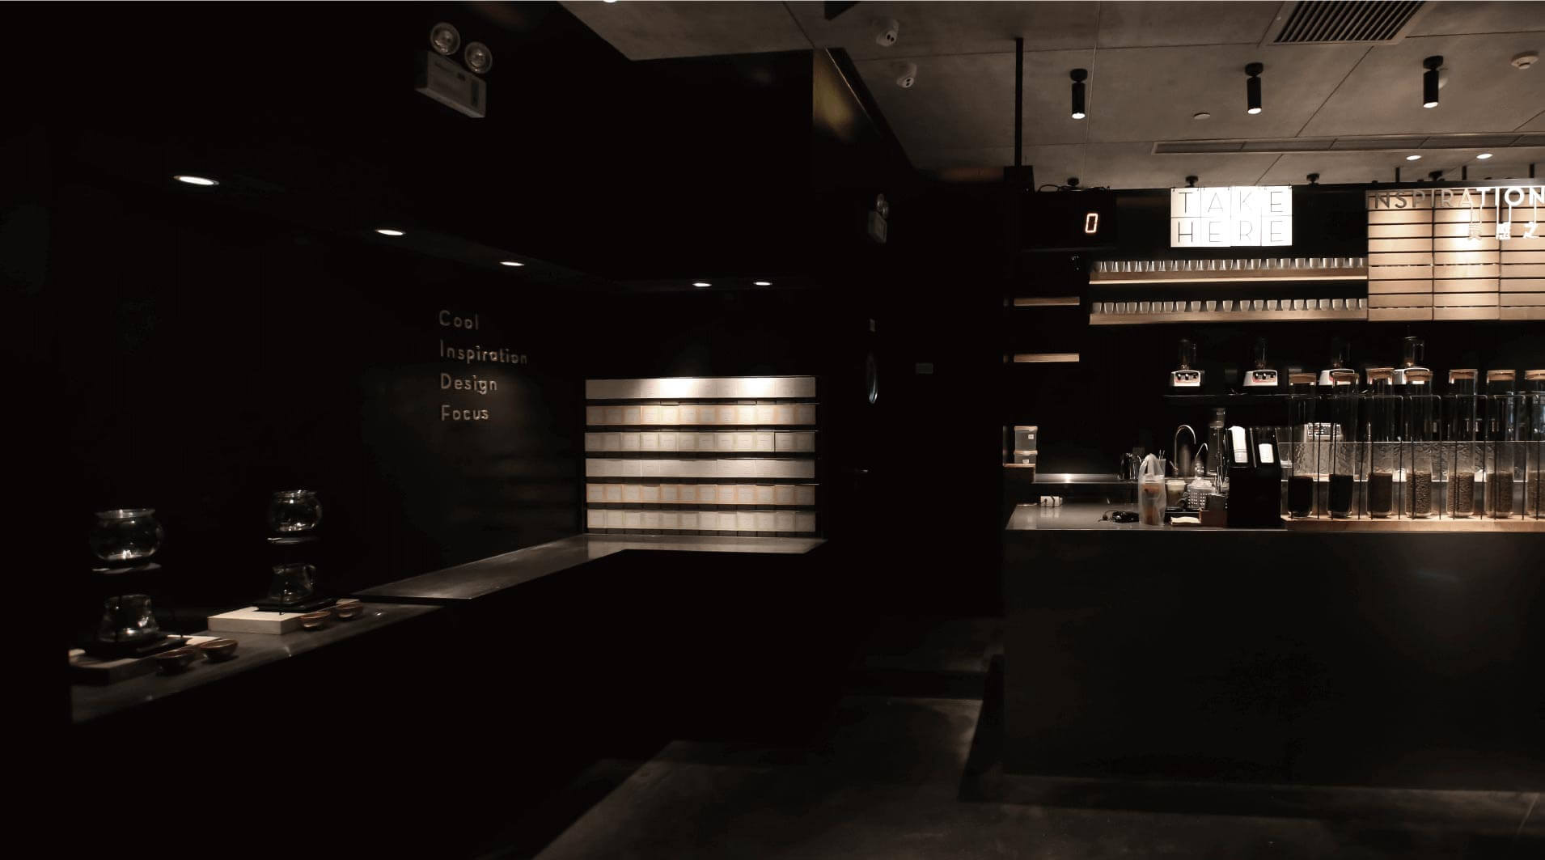
Thank you for your listening!
Any Question?

Slide 26
Appendix

Slide 27
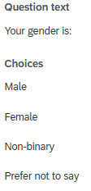
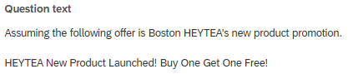
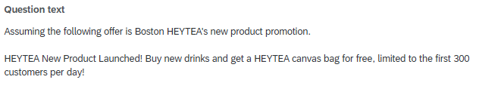
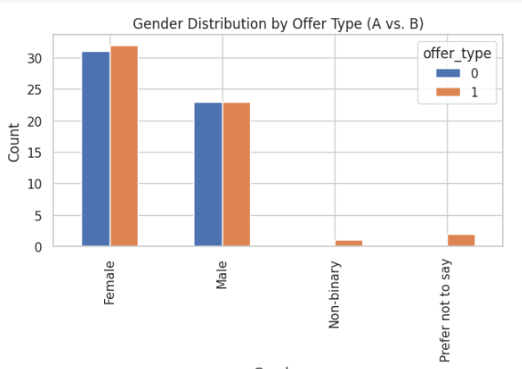
Analysis 1: Gender Distribution Across Promotional Offer Groups (Chi-Square Test)
Test Result

Slide 28
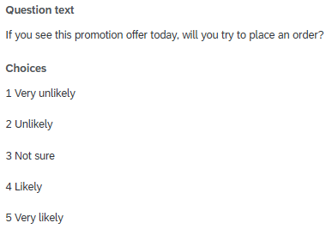
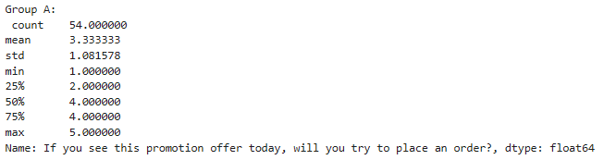
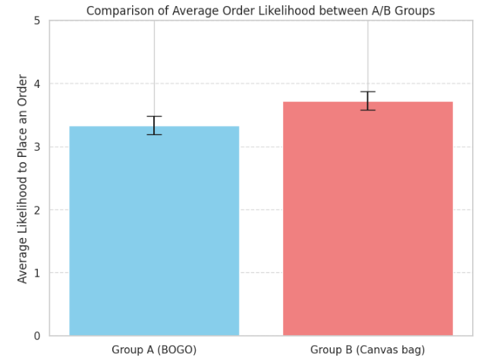
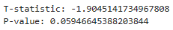
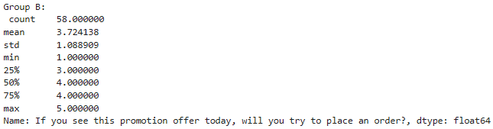
Analysis 2: Effect of Promotion Type on Likelihood to Place an Order (Independent Samples t-test)
Test Result

Slide 29
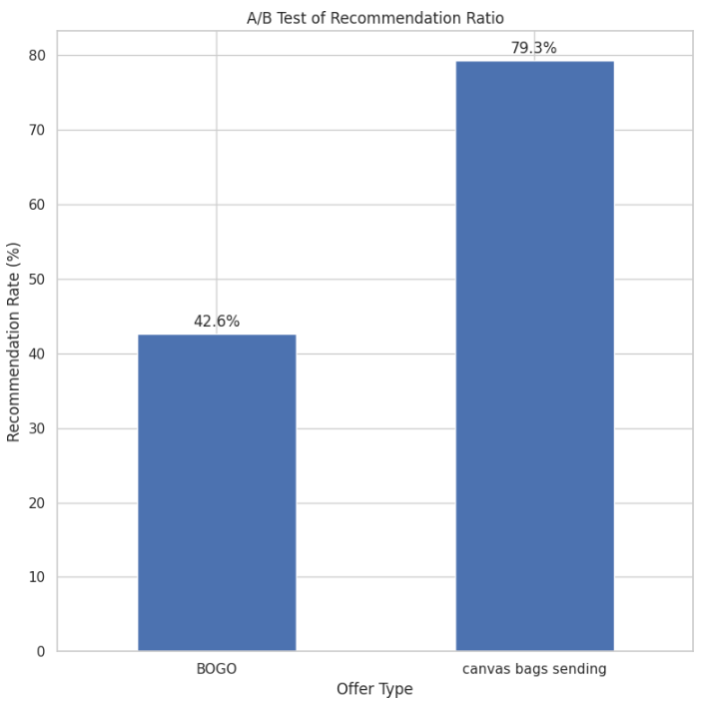
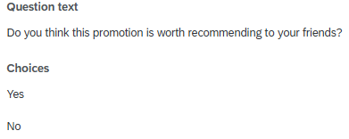
Analysis 3: Effect of Promotion Type on Recommendation Rate (Chi-Square Test)
Test Result：

Slide 30
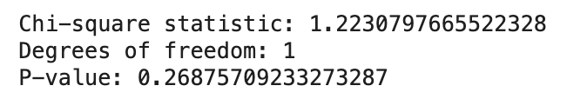
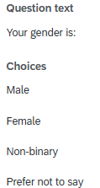
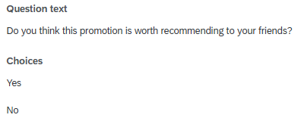
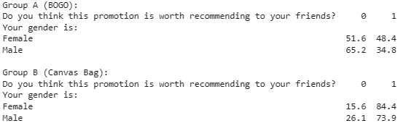
Analysis 4: Relationship Between Gender and Recommendation Likelihood (Chi-Squared)
Test Result：

Slide 31
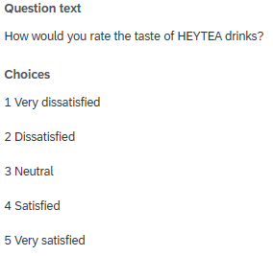
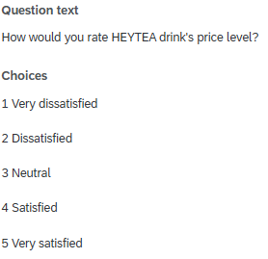




Analysis 5: Predictors of Customer Satisfaction (Multiple Linear Regression)

Slide 32

Analysis 5: Predictors of Customer Satisfaction (Multiple Linear Regression)
Test Result：

Slide 33

Analysis 6: Effects of Environment, Drink Taste, and Interaction on Satisfaction (Multiple Regression with Interaction)

Slide 34

Analysis 6: Effects of Environment, Drink Taste, and Interaction on Satisfaction (Multiple Regression with Interaction)
Test Result：

Slide 35



Analysis 7: Relationship Between Wait Time and Environment Rating (Pearson Correlation)
Test Result：

Slide 36

Follow-up Question - For customers who frequently visit HEYTEA
What would make you visit HEYTEA more frequently?
Options (Multiple Choice):
Shorter waiting time
More promotions and discounts
New drink flavors
More convenient store locations
Faster pick-up process
Improved in-store environment
Other (please specify)
Which aspect do you think HEYTEA should prioritize improving the most?
Options (Single Choice):
Drink Taste
Price Level
Waiting Time
Staff Service Attitude
Order/Pick-up Process
In-store Environment
Other (please specify)

Slide 37
Follow-up Question - For customers who frequently visit HEYTEA
When trying a new HEYTEA drink, how important are the following factors to you?
(Use a 5-point scale: 1 = Not important at all, 5 = Very important)
Ingredients and healthiness
Price of the new drink
Visual appearance of the drink
Novelty of the flavor
Recommendations from friends
Online reviews
HEYTEA often launches seasonal or limited drinks. Would you be interested in trying them if they were heavily promoted?
Options (Single Choice):
5 Very interested
4 Somewhat interested
3 Neutral
2 Not very interested
1 Not interested at all

Slide 38
Follow-up Question - For customers who frequently visit HEYTEA
If the waiting time exceeds 10 minutes, how likely are you to continue waiting for your HEYTEA order?
Options (Single Choice):
5 - Very likely
4 - Somewhat likely
3 - Neutral
2 - Somewhat unlikely
1 - Very unlikely
How often do HEYTEA promotions influence your purchasing decision?
Options (Single Choice):
5 – Very Frequently
4 – Frequently
3 – Occasionally
2 – Rarely
1 – Never

Slide 39
Follow-up Question - For customers who frequently visit HEYTEA
How would you prefer to receive updates or promotions from HEYTEA in the future?
Options (Multiple Choice):
WeChat official account
Text messages (SMS)
Red Note
Tik Tok
Other (please specify)______
If HEYTEA offered a mobile app with exclusive discounts and faster ordering, how likely would you be to download and use it?
Options (Single Choice):
5 - Very likely
4 - Likely
3 - Neutra
2 - Unlikely
1 - Very unlikely

